Slide 1


Differences in neural representative patterns between adults and children using naturalistic stimuli
Presented By:
William Mitchell
Notes:
Hi everybody Thank you so much for having me. My name is Billy Mitchell and I'm a graduate student in the Social and Affective Neuroscience lab at Temple.

Slide 2

Notes:
And I always have a hard time figuring out how I want to start presentations
but working in noisy places usually helps me concentrate, so when I was agonizing over how I wanted to start this talk, I figured I’d try going park near where I live in Philadelphia to work it out

Slide 3

Notes:
Lucky for me, there was plenty of background noise there
With an Encanto themed birthday party right in the middle Of the park.
Not only was it encanto themed, but they had a mirabelle impersonator there, who is the main character of the movie, if you’re not familiar.

Slide 4


Notes:
While the impersonator was there,
the kids were cheering,
parents were socializing,
It seemed like everyone was having a great time

Slide 5
Notes:
But eventually the impersonator had to leave and some of the kids did not take it well

Slide 6


Notes:
One child in particular started making a little bit of a scene, and understandably so. it was obvious that she was upset. I’m sure her mother was upset too,
but to her credit her mother kept her composure.
The mother tried comforting her daughter and when that didn’t work she gave her daughter two choices:
either she would have to behave and control herself or they would have to leave. Unfortunately, they weren’t at the party much longer,
but they did help me illustrate a major theme for my talk today.

Slide 7
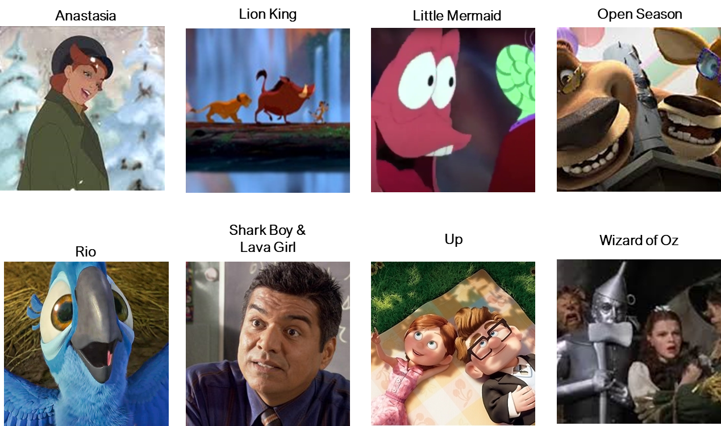





THE BIG QUESTION
How similarly do children and adults represent the same affective information?
Notes:
And so in this study we wanted to know

Slide 8
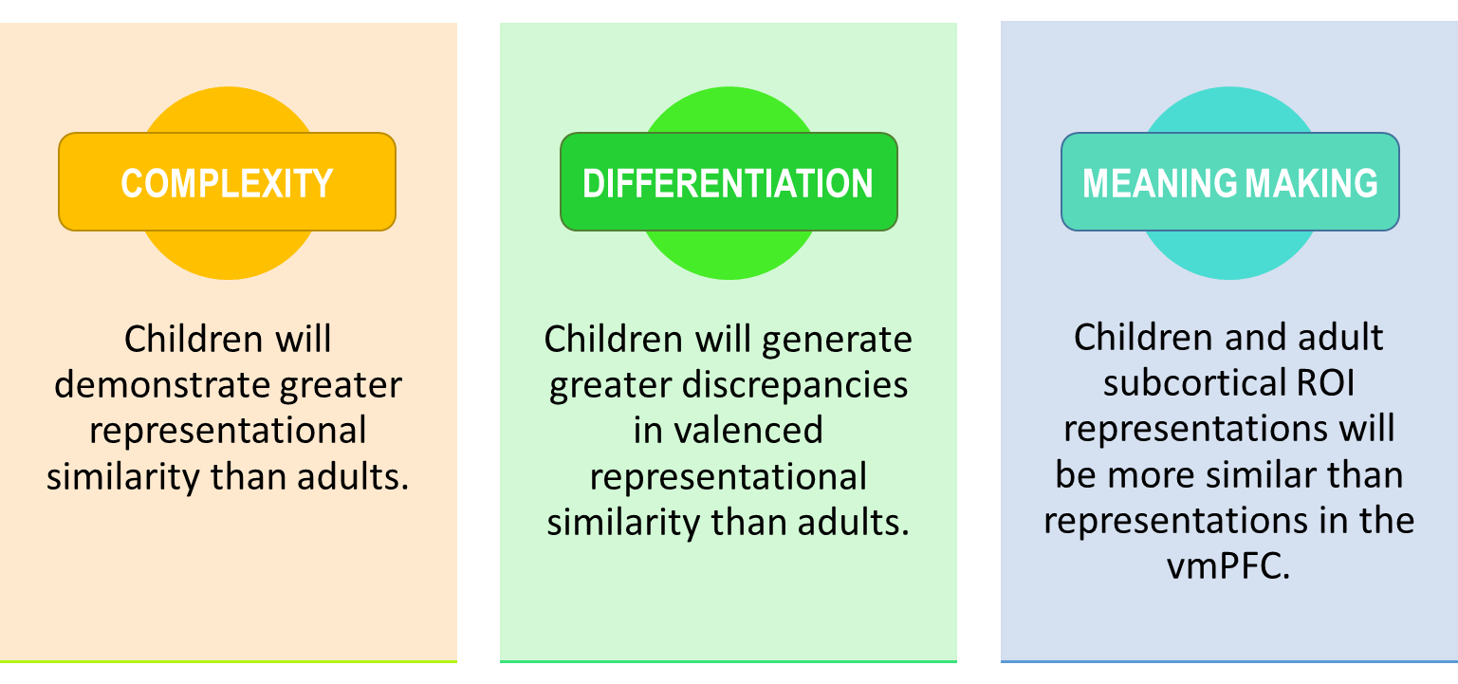
Hypotheses
Notes:
Three things we care about
Examples fit into the motivating examples
Adults can integrate multiple features, while children might not

Slide 9
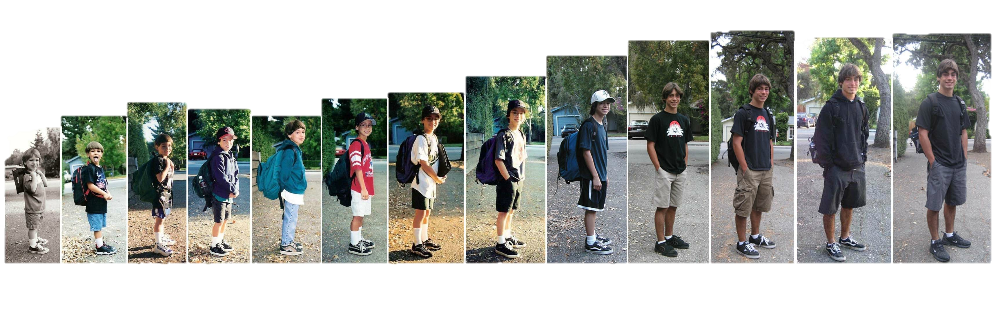
Development is a crucial context influencing affective cognitions, experiences, and expressions
Notes:
That being that development has a significant impact upon our affective cognitions, experiences, and expressions. This in and of itself isn’t really news. But where and how these differences can be observed is something we as scientists are still appreciating What we know so far

Slide 10
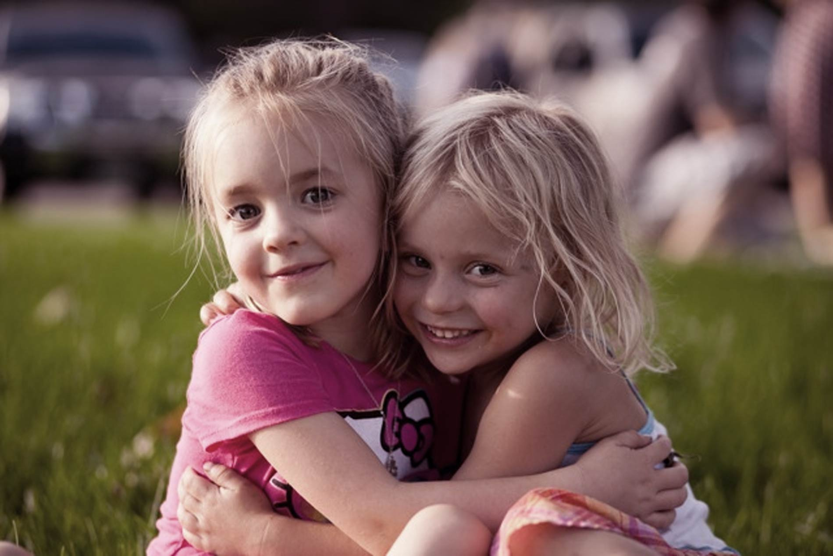
Development & Affective Behavior
Children behaviorally express emotions at about 6 weeks and semantically at about 2 years of age ¹.
Social Smiling
Emotion Labeling
Ability to read others’ emotions improves with age ²
Affective differentiation provides nuance with age ³
Valence still holds significance, but is not as defining to emotion differentiation in adulthood ⁴⁻⁶
1 Wellman et al., 1995
2 Fabes et al., 1991
3 Widen & Russel, 2003
4 Ansfield, 2007
5 Krumhuber and Manstead, 2009
6 Szczurek et al., 2012
Notes:
Is that emotion undergoes quite a bit of maturation throughout early development.
As early as 6 weeks, we see happiness expressed through behaviors like social smiling,
and by 2 years of age, we will typically see infants begin to label emotions.
These initial expressions and labels start fairly simplistically and falling along valenced lines
Like good and bad or happy and not-happy
Simultaneously, our ability to read the emotions of others or of situations improves with age as well.
Habituation studies suggest as early as 3 months, children can distinguish happy, angry, and surprised faces.
And between ages 3 and 7 children progressively develop the ability to identify happy, sad, angry, and fearful-eliciting situations
This is because experience and exposure from one’s family, peers, and a rich language environment,
We begin to see more emotional nuance emerge which develops throughout childhood and adolescence.
BY adulthood, we tend to see greater differentiation and variability in self-regulatory abilities which moderate affective experiences.

Slide 11
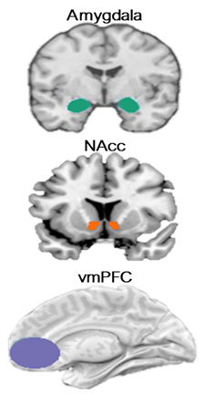


Affective Neural Development
In adults, AMY and NAcc project to vmPFC and vmPFC projects back to subcortical regions, constituting part of an affective self-regulatory loop. ¹⁻³ During development, projections from amygdala to vmPFC may emerge earlier than projections from vmPFC to amygdala ^{4,5}
Quality of vmPFC-AMY connectivity alters around age 10 ⁶
1 Davis and Whalen, 2001
2 Levita et al., 2009
3 Bjanji et al., 2019
4 Bouwmeester et al., 2002a
5 Bouwmeester et al., 2002b
6 Gee et al., 2013
Notes:
And there are a number of structural changes and functional changes that might be driving this behavioral maturation that we’d observed.
Because what we see in the affect literature are early deficits in the connectivity between regions we classically associate with interpretation or executive functions like the ventromedial prefrontal cortex and regions we often associate with valence assigners or visceral affective trackers like the amygdala and nucleus accumbens. Specifically, in adults we see robust projections from these subcortical structures to the vmPFC and then from the vmPFC back to these subcortical structures. Constituting part of an affective self-regulatory loop we often see activated during reappraisal tasks and similar self-regulation research.
However, it’s important to note that again, these structures undergo significant change during development. Animal research suggests that significant projections from the amygdala to the vmPFC may emerge much earlier than projections from the vmPFC to the amygdala
And that the quality of these connections once they do emerge only begin to resemble adult like qualities starting at age 10, with progress coming as the child develops. (PAUSE)
And so we know from this literature that at the level of affective neural systems there are differences between adults and children, and we know there are differences in behavior as well. What we know less about is what comes in between: the representing or modeling of affective information.

Slide 12


Neural regulatory development alters the representation of affective information between childhood and early adulthood ¹
1 Casey, Getz, & Galvan, 2008;
Notes:
Because it stands to reason that the differentiation that we see modeled in behavior
Should reflect differences in how affective information is represented neurally
And so our general thesis with this project was that
we should expect to see differences in neural representations of affective information between adults and children.
We have a family of approaches known as multivariate pattern analyses which are well suited for these sorts of questions
But the extent to which these have been applied to this specific question has been pretty limited thus far
And even more rarely has this approach used in conjunction with complex multimodal stimuli

Slide 13





Emotion is:
Dynamic
Multimodal
Multidimensional
Notes:
In a more traditional study, we might identify a static, IAPS-style stimuli set of affective images, ask participants to view them and then examine unimodal activation in specific regions. However this approach wouldn’t quite capture the nuance of affective representations. That’s because affect can unfold and change over a timecourse through a very dynamic process, affect is also attentive to multimodal experiences. You know, we’ve all seen a movie whose emotional impact was heighted by a very moving score underlying it. Affective processes are also multidimensional and can be characterized by valence, intensity, dominance and a number of other characteristics. Unfortunately, picture sets alone really don’t do a great job of capturing or representing some of these things

Slide 14
Traditional unimodal stimuli sets may not elicit sufficient affective responses
Naturalistic movie stimuli can move us towards greater ecological validity, yielding more accurate affective representations
Emotion is:
Dynamic
Multimodal
Multidimensional
Notes:
For this reason, traditional unimodal stimuli can often run into this problem where researchers fail to elicit sufficient affective responses. With recent advances in technical and computational resources, and plenty of pivotal studies that laid ground work for this appraoch, movie stimuli are not only feasible to use, but also might yield more accurate affective representations.

Slide 15
Experience
Perception
Representation
Behavior
THE BIG QUESTION
How similarly do children and adults represent the same affective information?
Notes:
if the stimuli were held constant

Slide 16
Experience
Perception
Representation
Behavior
THE BIG QUESTION
How similarly do children and adults represent the same affective information?
Notes:
Would we see similar representative patterns of neural activation between adults and children.

Slide 17
Stimuli
Twenty-four clips from popular children’s movies
8 pos., 8 neg., 8 neut.
Each film provided 1 pos. and 1 neg. clip
Neut. clips sourced from nature documentaries
No difference between adult and child familiarity scores
Clips were randomized into three orders and assigned to participants at random
Notes:
It consisted of 24 clips from popular movies
that were evenly divided into positive, negative, and neutral valence categories.
(PAUSE)
Clips contained both animated and live action movies,
anthropomorphic and human characters
and spanned a long time period, with release dates from 1939 to 2011.
In total, participants were exposed to about 20 minutes of continuous stimuli
(PAUSE)
So, again, we have a high volume of stimuli with a lot of variability surrounding a few core common traits.

Slide 18
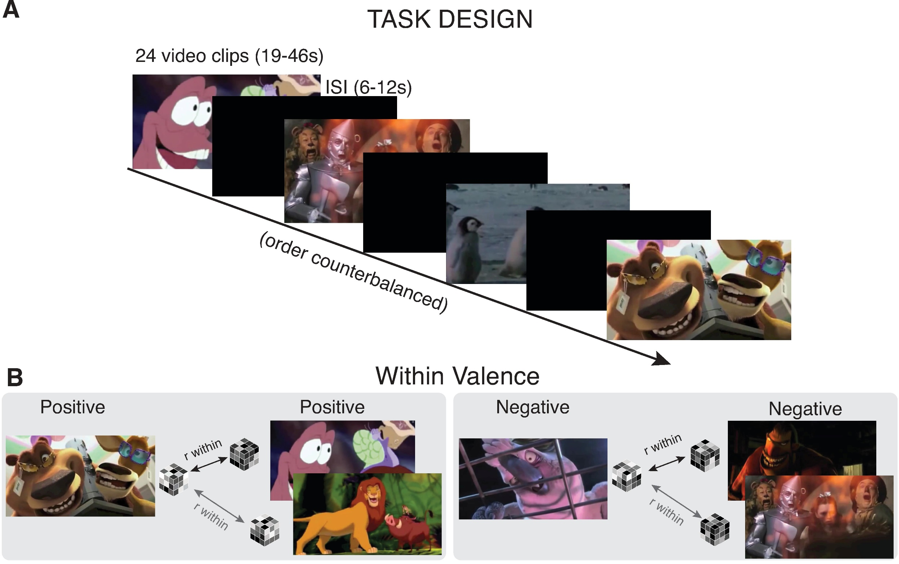
Why RSA?
Representational Similarity Analysis (RSA) is a statistical methodology that allows us to analyze relative similarity among a set of stimuli based upon the pattern that response to the stimuli produces.
Notes:
And this setup lent itself well towards and RSA approach
{READ DESC}
{TALK ABOUT STUDY DESIGN}
COMBINE WITH PREVIOUS

Slide 19
OLD SLIDE ON RSA

Slide 20

Our Data
57 participants
36 children, 21 adults
12 excluded for excessive head motion
Final sample:
25 Children
ages 4-10 (M =7.4 yrs, sd = 1.85 yrs)
20 Adults
ages 20 - 44 (M =26.7 yrs, sd = 5.20 yrs)
Notes:
We used a pre-existing dataset originally collected by Susan Perlman and her team,
That includes 57 participants that were either children between the ages of 4 and 10,
or adults between the ages of 20 and 44
who passively viewed video stimuli within the context of fMRI

Slide 21
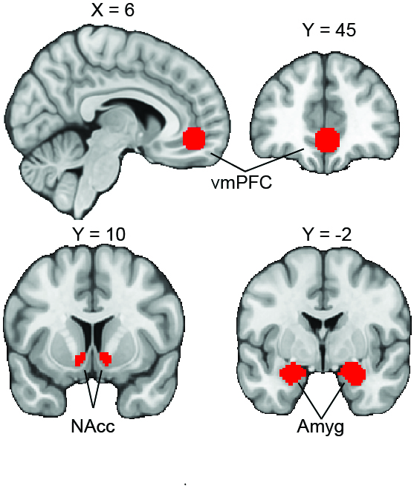
Regions of Interest
Amygdala
Nucleus Accumbens
Ventromedial Prefrontal Cortex
Masks Used
Notes:
We focused on these regions

Slide 22
Hypotheses
Notes:
Lastly, because of the profound functional and connective prefrontal developments,
relative to subcortical developments,
we expected to see an interaction
Such that the difference in pattern similarity between child prefrontal and subcortical regions
should be greater than the difference between adult prefrontal and subcortical regions.
(PAUSE)
And of course, we take this to be a sign that adults are demonstrating greater ability in that post-representation assessment stage.

Slide 23
Hypotheses
Notes:
And we wanted to test a few hypotheses with this setup First is what I would consider general complexity. Because from the behavioral research, we know that expressions of affect grow more nuanced as children age, we should expect to see that neural representations among children are generally more similar to one another than are adults

Slide 24

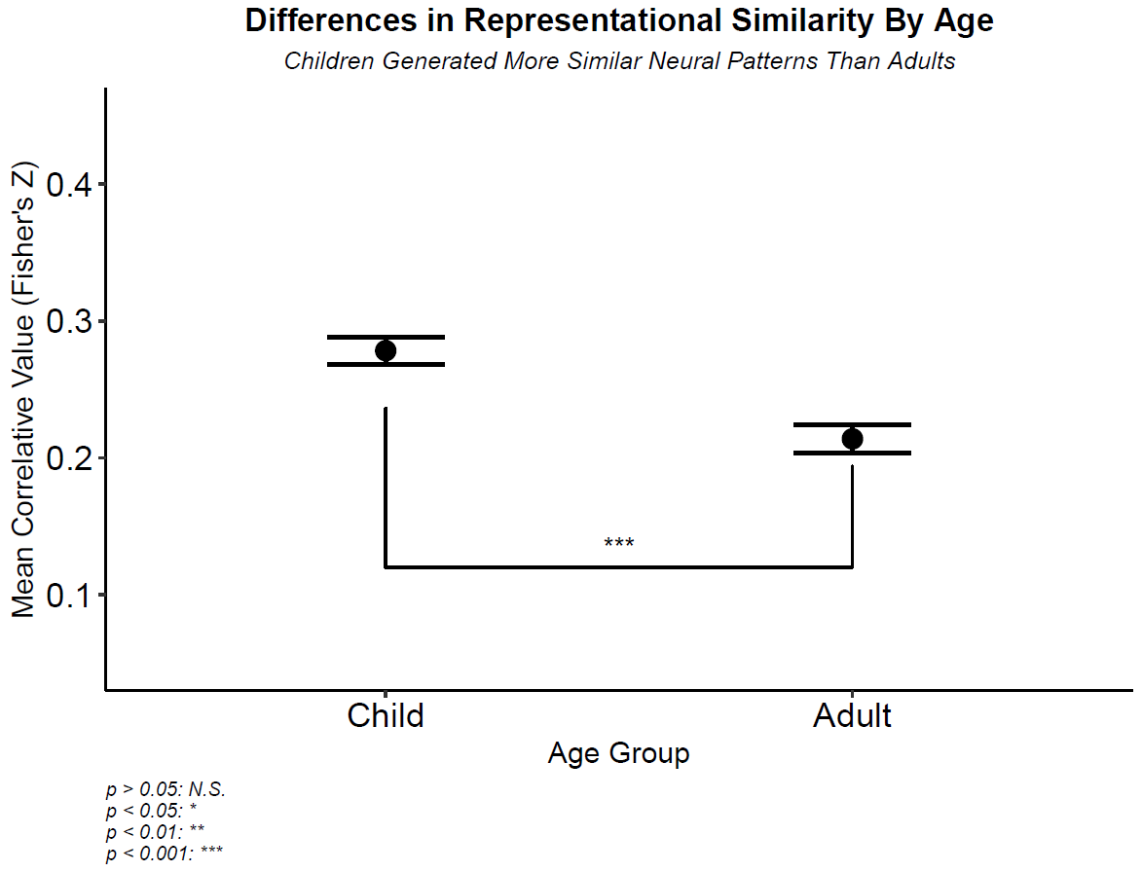
Supported
Overall, children did demonstrate greater pattern similarity relative to adults.
NOTE: FIGURES WILL BE REPLACED WITH MUCH NICER LOOKING VIOLIN PLOTS
Notes:
{TALK ABOUT AXES}

Slide 25
Supported
NOTE: FIGURES WILL BE REPLACED WITH MUCH NICER LOOKING VIOLIN PLOTS
Overall, children did demonstrate greater pattern similarity relative to adults.
NOTE: FIGURES WILL BE REPLACED WITH MUCH NICER LOOKING VIOLIN PLOTS

Slide 26
Hypotheses
Notes:
Building upon our first hypothesis we wanted to explore intra-valence differentiation across ages Researchers have theorized that children generate representations of affect that fall pretty strongly along valence lines,
while the complexity of affective representations in adulthood
Might render valence to be an insufficient framework to apply to adult representations.

Slide 27

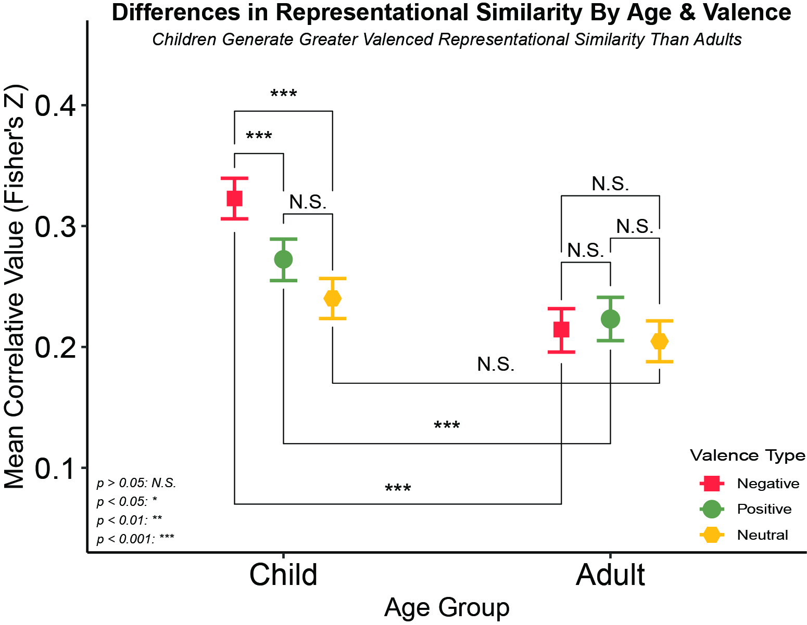
Supported
Children Generate Greater Valenced Representational Similarity Than Adults
Children also demonstrated greater affective pattern similarity relative to our neutral control, while adults did not seem to differentiate along affective lines.
Notes:
Going back to the interaction between valence and age in our mixed effects models, we actually found support for this notion. On the X axis, we have our age groups,
on the y axis we have our correlative values, and orange, green, and yellow for negative, positive and neutral valences respectively
so higher values mean that the patterns we observed were more similar to each other,
and lower values mean that they were less similar to each other within that specific Age / Valence group.
And lastly, we have valence as our moderator with relevant key over to the right.

Slide 28
Supported
Children Generate Greater Valenced Representational Similarity Than Adults
Children also demonstrated greater affective pattern similarity relative to our neutral control, while adults did not seem to differentiate along affective lines.
Notes:
First, we see no differences among adults by valence
This is in line with what we suspect, that valence might not be as appropriate of a heuristic or model for adults, being too general

Slide 29
Supported
Children Generate Greater Valenced Representational Similarity Than Adults
Children also demonstrated greater affective pattern similarity relative to our neutral control, while adults did not seem to differentiate along affective lines.
Notes:
For children, we do see differences between negative and positive and positive and neutral,
But interestingly enough not positive and neutral
This difference could be a product of the prominence a lot of negatively valenced events demonstrate
Especially in moral domains for children.

Slide 30
Supported
Children Generate Greater Valenced Representational Similarity Than Adults
Children also demonstrated greater affective pattern similarity relative to our neutral control, while adults did not seem to differentiate along affective lines.
Notes:
But, most important,
We see that both positive and negative, but not netural valenced stimuli,
Generated greater pattern similarity in children relative to adults,
Again which suggests that children are representing negative things pretty similarity to other negative things
And positive things pretty similarity to other positive things,
And not differentiating as much nuance as their adult counterparts seem to be doing

Slide 31
Hypotheses
Notes:
Lastly, because of the profound functional and connective prefrontal developments,
relative to subcortical developments,
we expected to see an interaction
Such that the difference in pattern similarity between child prefrontal and subcortical regions
should be greater than the difference between adult prefrontal and subcortical regions.
(PAUSE)
And of course, we take this to be a sign that adults are demonstrating greater ability in that post-representation assessment stage.

Slide 32

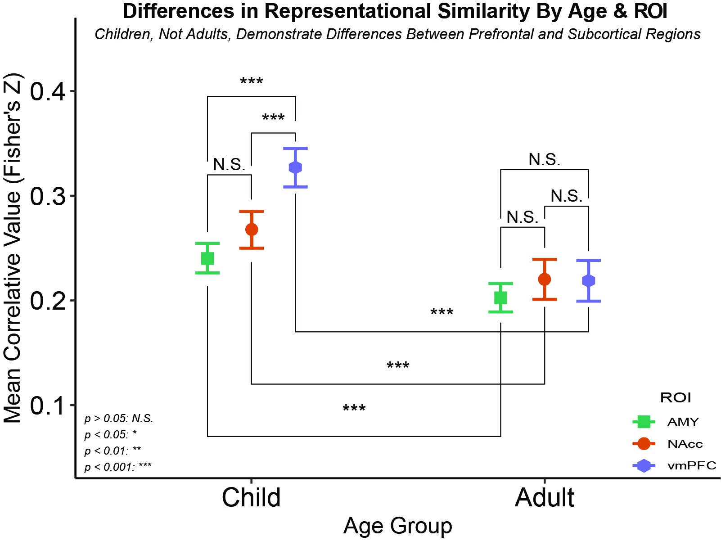
Supported
Adults demonstrated no ROI differences while children demonstrated differences between the vmPFC and each subcortical structure
Notes:
We again have our age groups on the X axis
on the y axis we have our correlative values,
And our ROIs are represented in the legend, with the amygdala being sort of turquoise, the nucleus accumbens being orange, and the vmPFC being purple.
And lastly, we now have ROI as our moderator with a little reminder of where each region is located on the left.

Slide 33
Supported
Adults demonstrated no ROI differences while children demonstrated differences between the vmPFC and each subcortical structure
Notes:
We again see little pattern similarity among adults by region

Slide 34
Supported
Adults demonstrated no ROI differences while children demonstrated differences between the vmPFC and each subcortical structure
Notes:
However, children show far greater pattern similarity in the vmPFC than they do subcortical regions

Slide 35
Supported
Adults demonstrated no ROI differences while children demonstrated differences between the vmPFC and each subcortical structure
Notes:
Despite all regions showing a movement towards greater dissimilarity overall in the older cohort, the difference between the vmPFC and subcortical regions is more pronounced in children relative to adults.

Slide 36
Summary
Children did demonstrate pattern similarity across stimuli than adults
1
Children did demonstrate more similar patterns in response to negative stimuli than positive stimuli; adults did not
2
Children vmPFCs demonstrated greater pattern similarity than subcortical regions; adults did not
3
COMPLEXITY
DIFFERENTIATION
MEANING MAKING
Notes:
[Read the slide]

Slide 37

Implications
Affective representations may decrease in pattern similarity over normative development

Slide 38
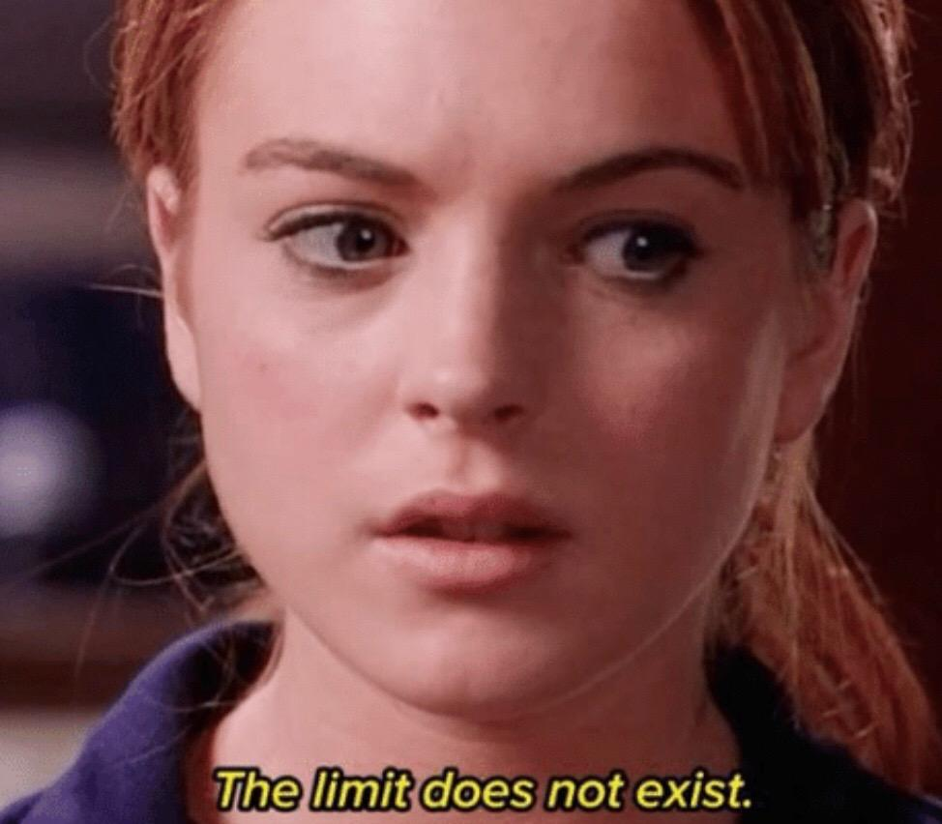

Limitations of Our Approach
Relatively small sample size
Lack of adolescent representation
Cannot comment on contents of representations
Notes:
But of course, this study should really only be thought of as a very limited first pass in this space. First we have a fairly small sample for the span of development we are trying to capture. It’s also notable we have a massive gap in our sample, in that we have no adolescents
which might really complicate these relatively simplistic theories We also cannot make the claim that these representations are definitively affecting downstream processes Because we only examined passive viewing, we did not ask them to make decisions and we cannot be 100% sure about the contents of these representations But we have some work in the pipeline that I’m very excited and that will address these limitations

Slide 39

Conclusions
Differences in neural representations of affective information can be observed between children and adults.
Naturalistic stimuli with can be used to elicit these differences.
These differences may support behavioral studies documenting affective and regulatory development.
Notes:
Evaluative vs integrative
Hit home more on the naturalistic benefits as well
Kids struggle with traditional paradigms
Explain the upstream thing

Slide 40








Special Thanks to my co-authors:
Chelsea Helion
Lindsey Tepfer
Nicole Henninger
Vishnu Murty
Susan Perlman
… and my lab mates:
Joy Ham
Ginny Ulichney
Helen Schmidt

Slide 41


